Slide 1

Heart Stroke Prediction
By Group 12:
Abbasi, Seyed Amir Kiarash
Alan, Baris
Ardalanasl, Mohammad
Khimani, Renish Samir
Li, Chue San Gavin
Maran Vieira Da Silva, Taiguara
Mehmood, Hassan
Monzato Grigorio, Gabriel
Thomas, Shane

Slide 2
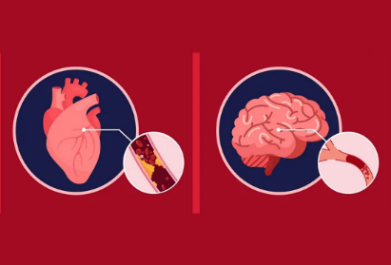

Predicting Heart Stroke
How are we going to predict?
The Data
Gathered data from Kaggle .
Identified the risk factors associated with Heart Stroke.
Finding the probability of the risk of Heart Stroke based on historical data.
Defining it as a classification problem.
Residence Type
Average Glucose Level
BMI*
Smoking Status
Stroke
ID
Gender*
Age*
Heart Disease
Hypertension
Ever married
Work type

Slide 3
Exploratory Data Analysis:
Feature | Data Type
id | int64
gender | object
age | float64
hypertension | int64
heart_disease | int64
ever_married | object
work_type | object
Residence_type | object
avg_glucose_level | float64
bmi | float64
smoking_status | object
stroke | int64
Features | No. NaN
id | 0
gender | 0
age | 0
hypertension | 0
heart_disease | 0
ever_married | 0
work_type | 0
Residence_type | 0
avg_glucose_level | 0
bmi | 201
smoking_status | 0
stroke | 0
No. Features: 11
No. Records: 5108
Categorical Features | No. Categories
gender | 3
ever_married | 2
work_type | 5
Residence_type | 2
smoking_status | 4

Slide 4
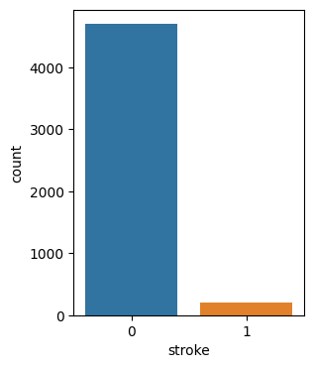
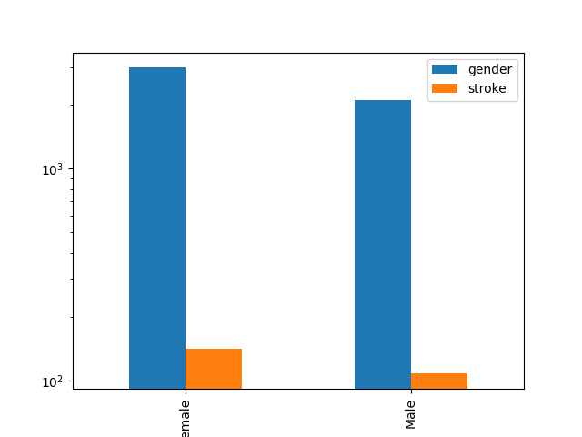
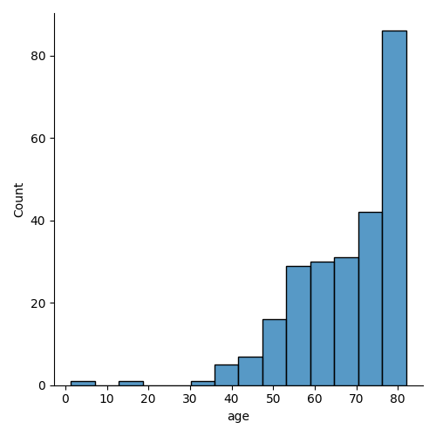
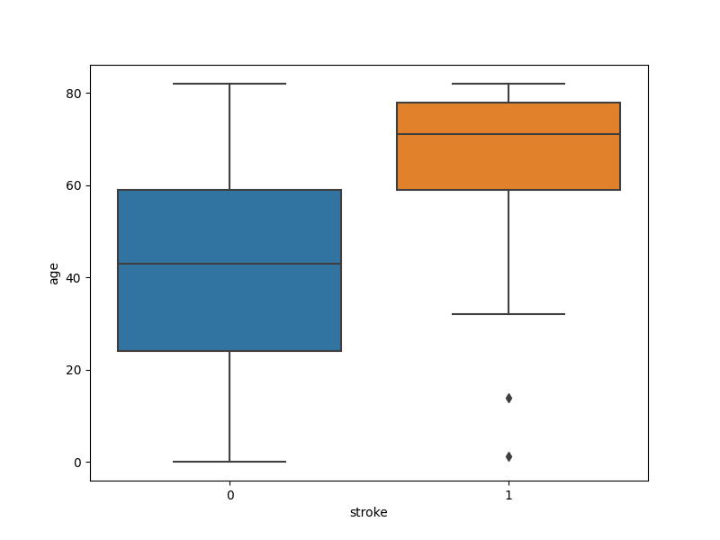
Imbalanced Data
Age and Stroke.
Distribution of age with respect to incidence of stroke.
Gender representation in data.
Class Imbalance.

Slide 5
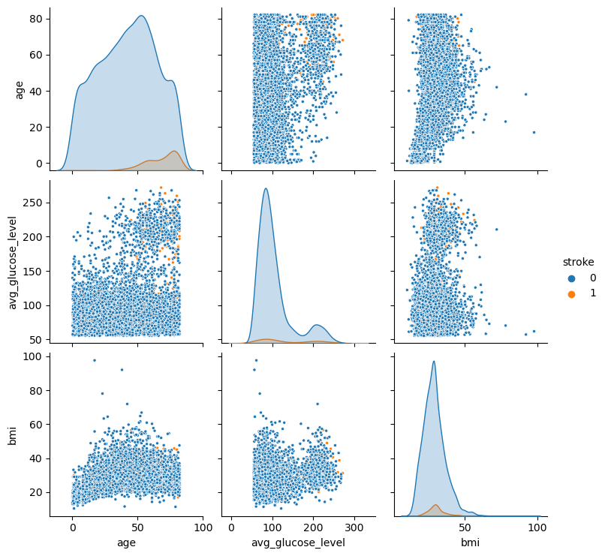
Data Distribution
Data Distribution Overview:
Higher Correlation:
Age and stroke.
Glucose Level and stroke

Slide 6
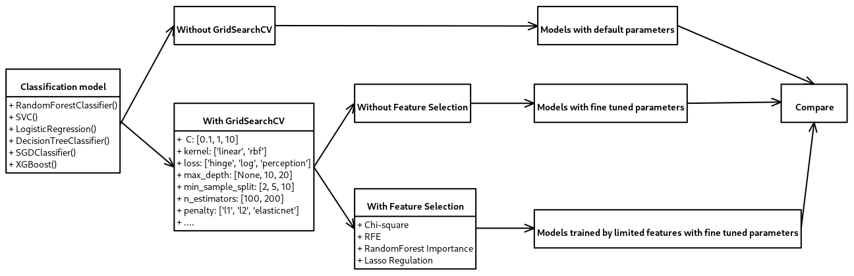
Model selection

Slide 7
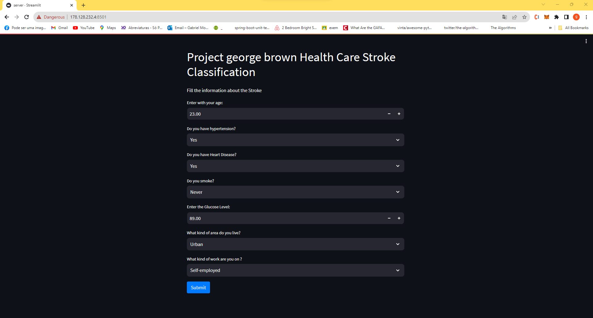
Application to make this model discover a product

Slide 8
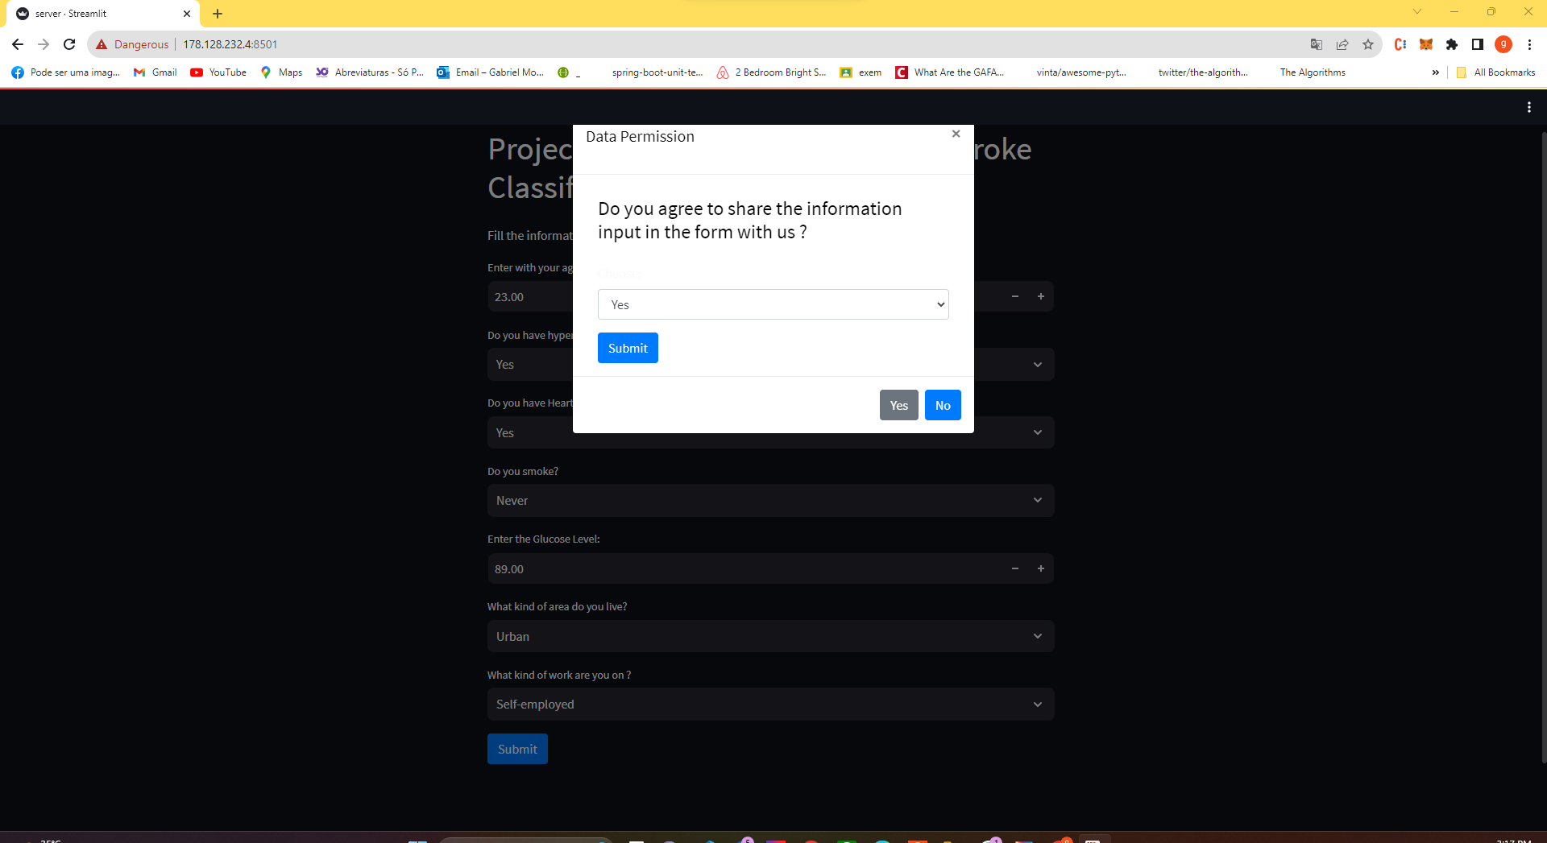
Ask for permission to use the data filled from the user

Slide 9
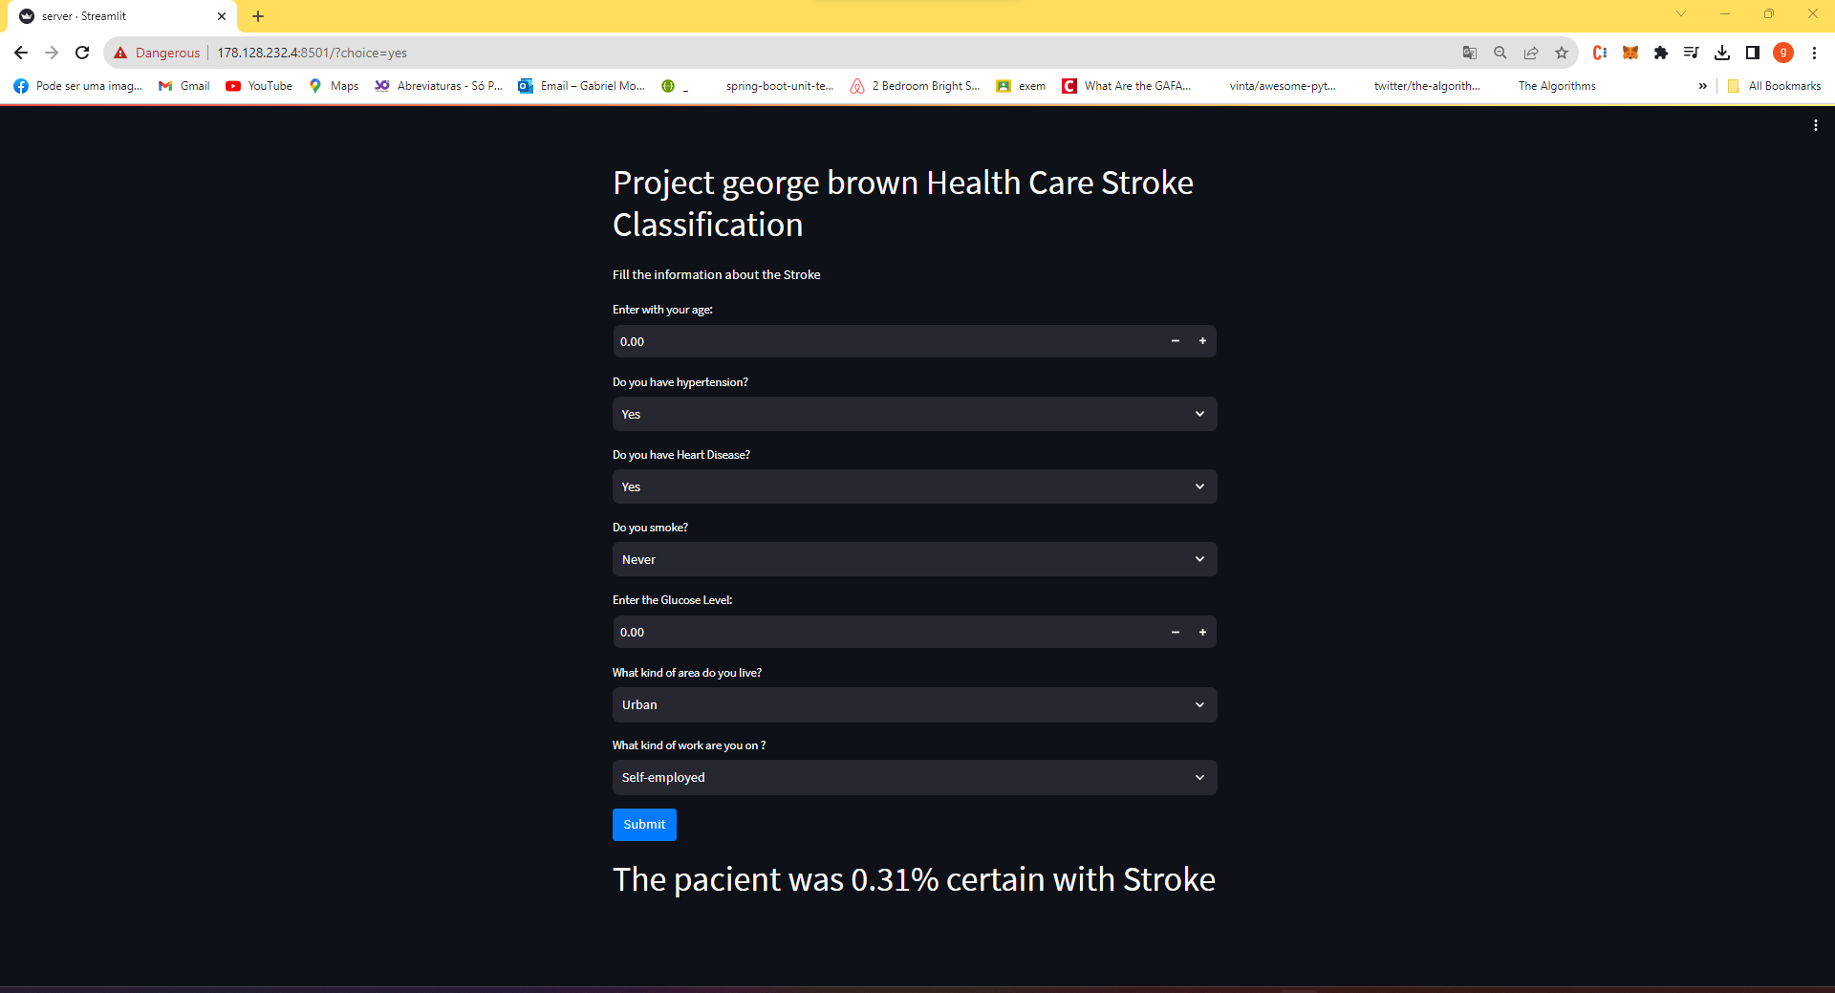
After the approve from the patient the data is send to the server and return the prediction about stroke

